Slide 1

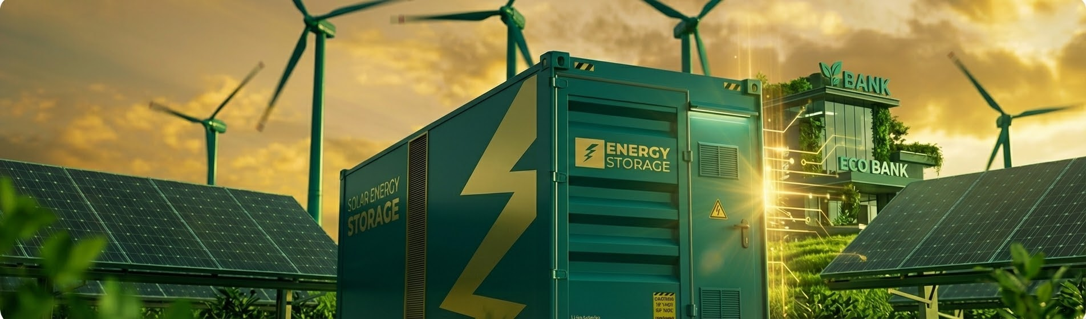
Allotrope Vietnam Progress Update For Tara
Greening the Banks & Energy Storage in Vietnam
December 2025

Slide 2


Greening the Banks Vietnam
Progress Updates

Slide 3

Greening the Banks Vietnam:
Status Update on Outputs
Objectives | Outputs | Status
1. Collaborate with two champion banks in Vietnam (1 state-owned and 1 commercial bank) on tangible portfolio-wide measurement and action | Develop GHG assessment reports with two champion banks | Completed for BIDV
 | Produce a high-level net zero transition roadmap for one champion bank to serve as a first-in-market example | In Progress (Near completion)
2. Support the advancement of green financing instruments to reduce emissions within the lending portfolios of the two major champion banks and disseminate lessons learned | Provide direct technical support on structuring to advance the execution of three SLL transactions in collaboration with at least one of the two champion banks | In Progress
 | Execute 1 closed-door session to bring together one champion bank alongside select developers or other private sector stakeholders seeking to finance innovative storage projects or supply chain decarbonization. | In Progress
 | Develop at least one case study knowledge product to disseminate key lessons and targeted insights from the GHG assessment, net zero transition roadmap, and SLL support | In Progress
Notes:
Deliverable 1 Carbon footprint and Emissions reduction strategies (06 reports + 02 tools)
For BIDV:
1) Report for Scope 1&2 emission reduction (completed)
2) Report for Scope 3 non financed emission (completed)
3) Report for Scope 3 financed emission (almost completed)
4) Calculation tool for Scope 3 (non financed and financed) (almost completed)
For TCB:
1) Report for Scope 1&2 emission reduction (completed)
2) Report for Scope 3 financed emission (almost completed)
Deliverable 2 Net zero transition roadmap (02 report)
For BIDV:
1) Net zero transition roadmap for financed emission (not yet)
For TCB:
1) Report for setting target & financed emission disclosure (almost completed)

Slide 4

State-Owned Champion Bank Collaboration:
BIDV Progress Update - Summary
Develop GHG assessment reports
Scope 3 Non-Financed:
Completed
Scope 3 Non-Financed:
Waiting for a response from BIDV
1
Scope 3 Financed:
Completed
Scope 3 Financed:
Waiting for a response from BIDV
Produce a high-level net zero transition roadmap to serve as a first-in-market example
Scope 1 & 2 Roadmap:
Completed
Scope 1 & 2 roadmap:
Waiting for a response from BIDV
2
Scope 3 Non-Financed roadmap:
Proposed changes the content
Scope 3 Non-Financed roadmap:
BIDV proposes transferring this report to the Report on Proposed Methods for Collecting Other Key Categories for 2026
Scope 3 Financed roadmap:
Finalizing report
Scope 3 Financed roadmap:
After receiving feedback from the inventory report, the roadmap report will be finalized.
Toolkits: 2/3 completed
Toolkits: Finalizing database for financed emission factors
Notes:
Deliverable 1 Carbon footprint and Emissions reduction strategies (06 reports + 02 tools)
For BIDV:
1) Report for Scope 1&2 emission reduction (completed)
2) Report for Scope 3 non financed emission (completed)
3) Report for Scope 3 financed emission (almost completed)
4) Calculation tool for Scope 3 (non financed and financed) (almost completed)
For TCB:
1) Report for Scope 1&2 emission reduction (completed)
2) Report for Scope 3 financed emission (almost completed)
Deliverable 2 Net zero transition roadmap (02 report)
For BIDV:
1) Net zero transition roadmap for financed emission (not yet)
For TCB:
1) Report for setting target & financed emission disclosure (almost completed)

Slide 5
State-Owned Champion Bank Collaboration:
BIDV Progress Update - Sustainability Linked Loans
CHALLENGES
PROPOSED SOLUTIONS &
NEW DIRECTION
3
SLL Support
Economic Context: Enterprises prioritize resources for business and often do not see the connections to green transformation. Exporting enterprises only do enough to meet the conditions.
Technical: SLL has complex technical factors, affecting customers' decisions.
Financial: The current SLL lending interest rate does not create enough motivation; the current credit growth rate is quite low.
Business Psychology: Some companies fear losing competitive advantage if ESG information is made public and have expressed concerns about "greenwashing" due to unclear regulations in Vietnam.
Updated Strategy: Engage targeted potential customers and expand the scope of our objective to support the advancement of green financing instruments, by exploring Transition Plans in addition to SLLs.
Next Steps:
BIDV is engaging 20 customers through early Q1 to promote green financing instruments including SLLs and transition plans and will arrange an in-depth consultation meeting between Allotrope and a potential customer.
Allotrope will summarize lessons and share relevant materials with interested customers.
Future Approach: Engage banks and clients to explore Transition Plans, anticipating the application of emission quotas from 2026.
Notes:
Contingency Planning: If difficulties arise in structuring three viable SLL transactions within the timeframe due to market constraints, client readiness, or other factors, Allotrope can prioritize in-
depth support for structuring at least one highly robust and demonstrative SLL transaction rather than aiming for a larger number with less comprehensive support.

Slide 6
Commercial Champion Bank Collaboration:
TCB Progress Update - Summary
Develop GHG assessment reports
Scope 1 & 2 updated:
Completed
Scope 1 & 2 updated:
Waiting till December 31 for final data
Scope 1 & 2 reduction:
Completed
Scope 1 & 2 reduction:
Waiting for a response from TCB
1
Scope 3 Financed:
Finalizing report
Scope 3 Financed:
To be submitted December 2025
Scope 3 Financed Disclosure and Target:
Finalizing report
Scope 3 Financed Disclosure and Target:
To be submitted January 2025
Toolkits: 1/2 completed
Toolkits: Finalizing database for financed emission factors
Notes:
Deliverable 1 Carbon footprint and Emissions reduction strategies (06 reports + 02 tools)
For BIDV:
1) Report for Scope 1&2 emission reduction (completed)
2) Report for Scope 3 non financed emission (completed)
3) Report for Scope 3 financed emission (almost completed)
4) Calculation tool for Scope 3 (non financed and financed) (almost completed)
For TCB:
1) Report for Scope 1&2 emission reduction (completed)
2) Report for Scope 3 financed emission (almost completed)
Deliverable 2 Net zero transition roadmap (02 report)
For BIDV:
1) Net zero transition roadmap for financed emission (not yet)
For TCB:
1) Report for setting target & financed emission disclosure (almost completed)

Slide 7
Looking Ahead:
Proposed 2026 GTB Vietnam Activities
Proposed Engagement for 2026:
Provide advanced analytics and training for champion banks on quantifying financed emissions, setting science-based targets, and embedding climate intelligence into core lending decisions
Address key market gap by offering hands-on technical support for relationship managers and product teams on structuring credible and ambitious green and sustainability-linked transactions
Questions and Discussion
Questions from Tara on our Greening the Banks Vietnam project?
Further insights on Tara’s 2026 requirements and timelines?
Timeline for proposed list of activities where BIDV is seeking Allotrope’s support in 2026?
The instrumental nature of engaging commercial banks to facilitate Vietnam’s energy transition in a moment of scarce resources for private sector mobilization?

Slide 8

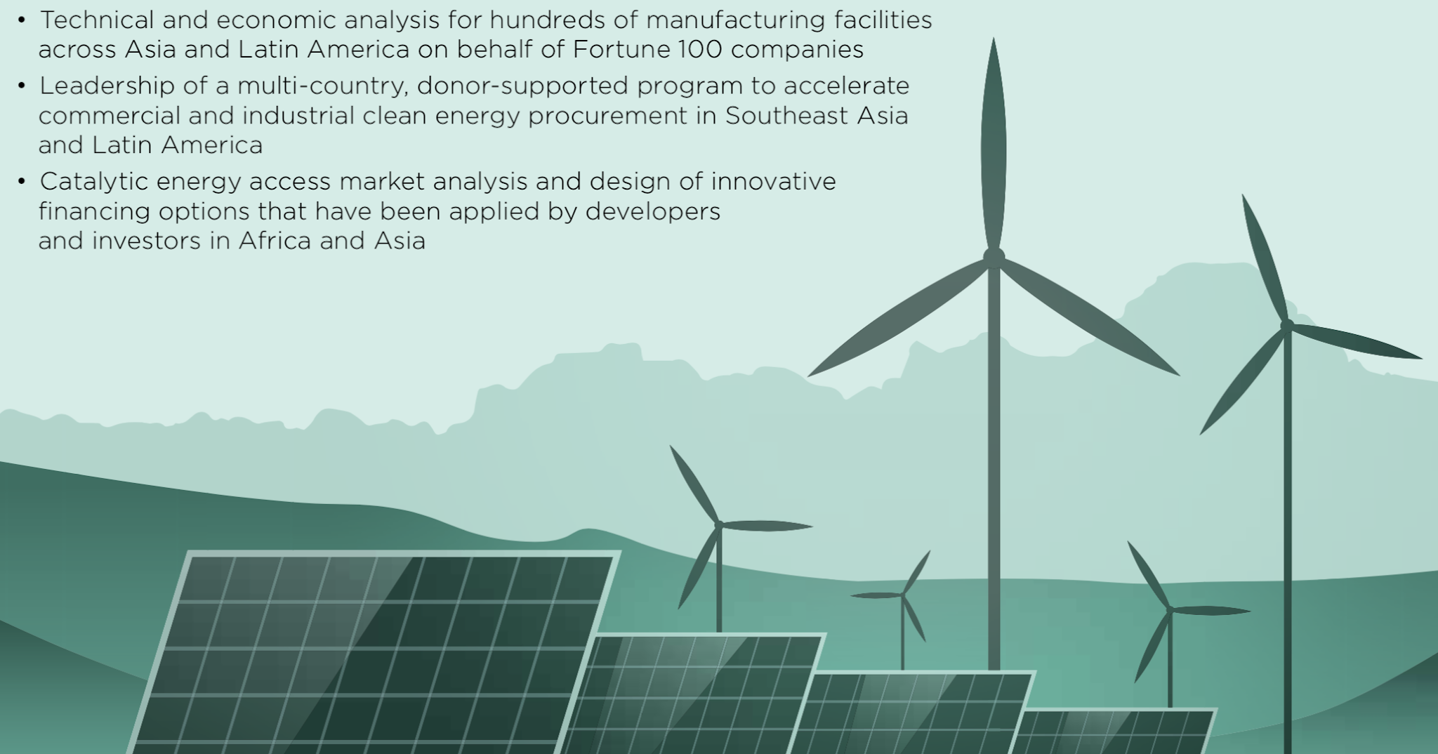
Tung Ho, tah@allotropepartners.com
Hang Tran, httt@allotropepartners.com
Cong Nguyen, chn@allotropepartners.com
Hong Anh Le, hal@allotropepartners.com

Slide 9
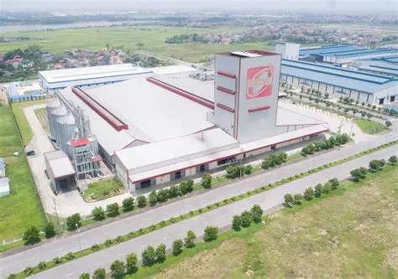
Site Analysis 1:
Emivest: Behind-the-Meter BESS
Company | Emivest Feedmill (Vietnam) Co., Ltd.
Industry | Livestock feed production
Location | Dong Nai Province, Vietnam
Operation | Continuous production: 3 shifts/day with no operations on Sunday
Load Profile | High, flat base load with minimal fluctuation
Key Equipment | Feed grinders, mixers, conveyors, pelletizers
Tariff Structure | Time-of-Use Industrial rates
Existing RE/BESS | 3,221 kWp rooftop solar; No BESS
Main Challenges | High solar energy curtailment
BESS Opportunity | Peak shaving, solar+BESS integration
Data Collected | 5-min interval load data (5 months), tariff/bill info, ops constraints

Slide 10
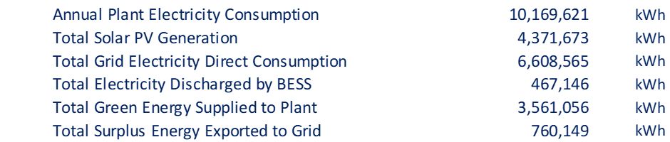
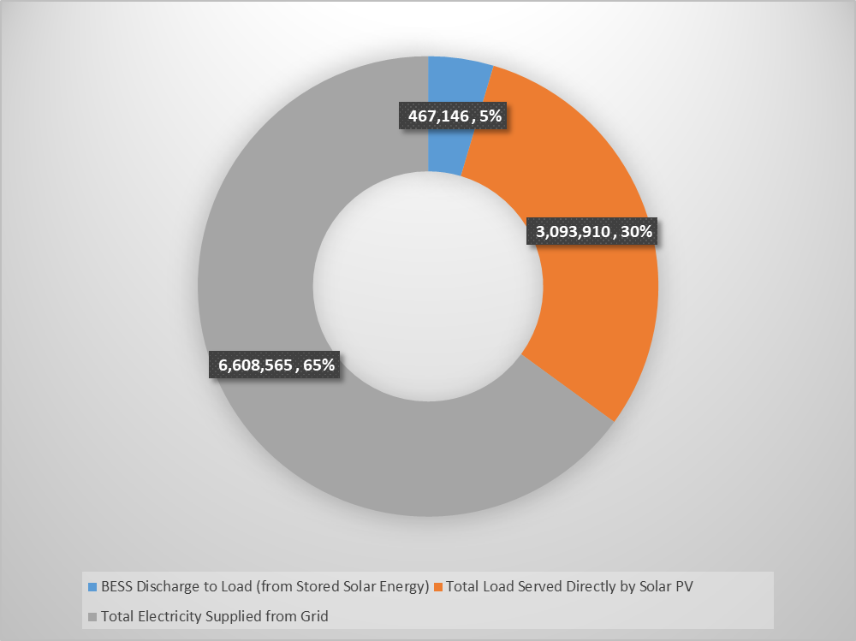
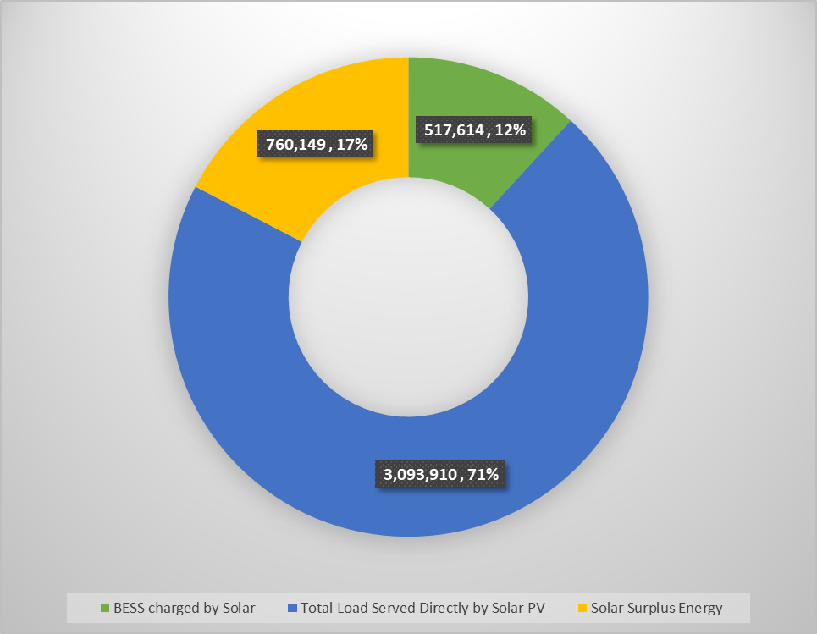
Site Analysis 1:
Emivest: Behind-the-Meter BESS
The existing 3,221 kWp rooftop solar system at the site consistently generates more energy than the factory consumes during daylight hours. Approximately 29% of annual solar generation is surplus, typically occurring between 9:00 and 14:00 depending on the season.
Integrating BESS can capture this excess solar generation and shift it to evening consumption hours, enabling optimal energy utilization and investment returns.
All input parameters are based on conservative industry standards and battery manufacturer guidelines to ensure long-term system reliability and battery health.
Load Consumption vs Energy Supply
Total Solar PV Energy Distribution

Slide 11





Site Analysis 1:
Emivest: Conclusions and Key Takeaways
Significant Solar Surplus
Optimal BESS Sizing
Strong Financial Viability
Effective Peak Shaving Strategy
Sensitivity to Costs
The factory's 3,221 kWp PV system generates a substantial energy surplus, with approximately 29% of its total annual generation available to be captured by a BESS.
A BESS with a 3-hour storage duration is identified as the most cost-effective solution, providing optimal energy shifting capabilities at a lower capital cost compared to other configurations.
The project is financially attractive under a 15-year PPA model, demonstrating a robust project internal rate of return (IRR) of 9.2% (conservative scenario)
The proposed BESS operational strategy successfully shifts captured solar energy to evening peak hours, with over 83% of the battery's annual discharge occurring during the most expensive tariff periods, maximizing cost savings.
The project's profitability is highly sensitive to the upfront CAPEX. Securing competitive equipment and installation costs will be critical to achieving the projected returns.

Slide 12
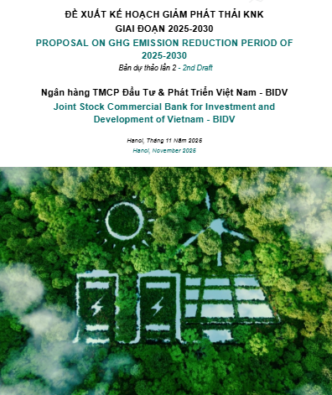
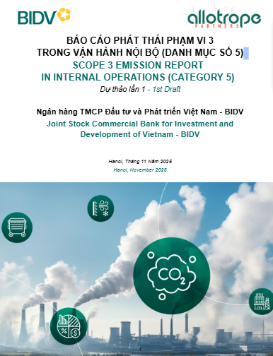
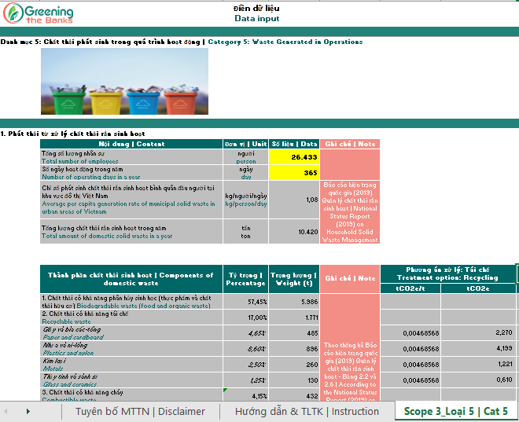
State-Owned Champion Bank Collaboration:
BIDV Progress Update - Scope 1,2, 3 Non Financed Report and Tool Completed
Scope 1 & 2 reduction: Completed
Scope 3 Non-Financed: Completed report + Toolkit

Slide 13
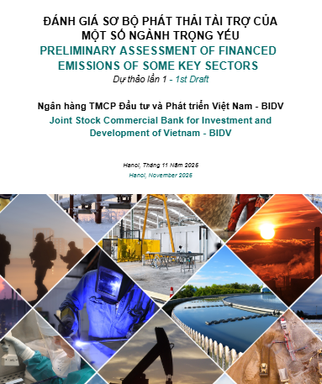
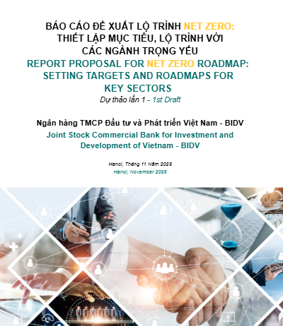
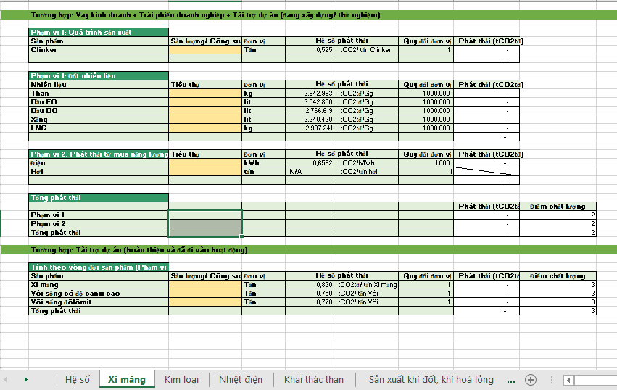
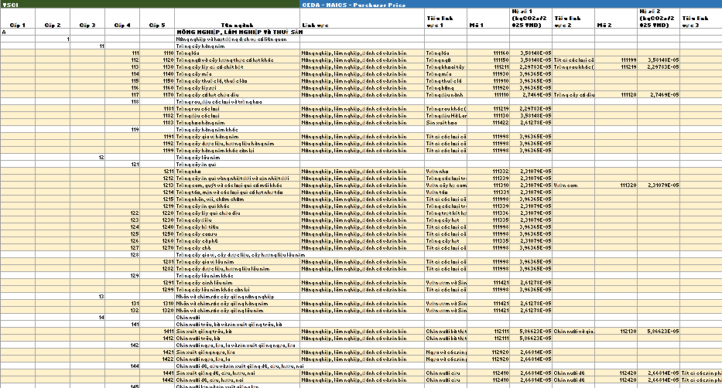
State-Owned Champion Bank Collaboration:
BIDV Progress Update - Scope 3 Financed Report and Tool in Progress
Scope 3 financed toolkits: In progress
Scope 3 financed: Completed
Scope 3 financed roadmap: In progress

Slide 14
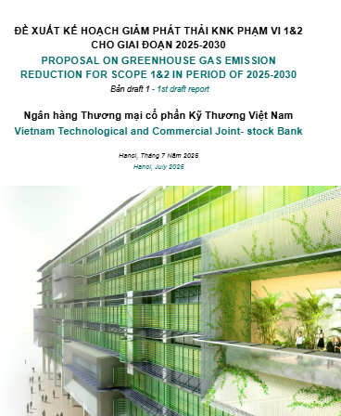
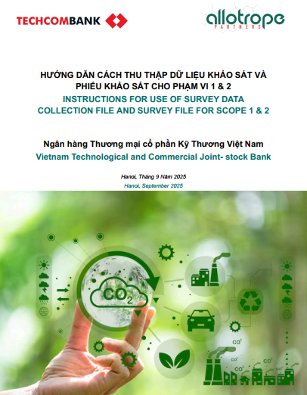
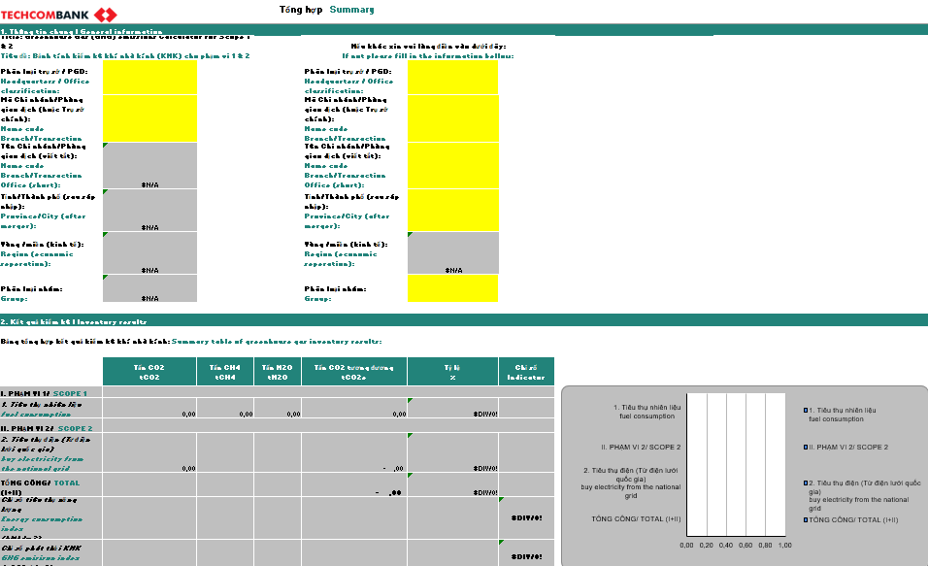
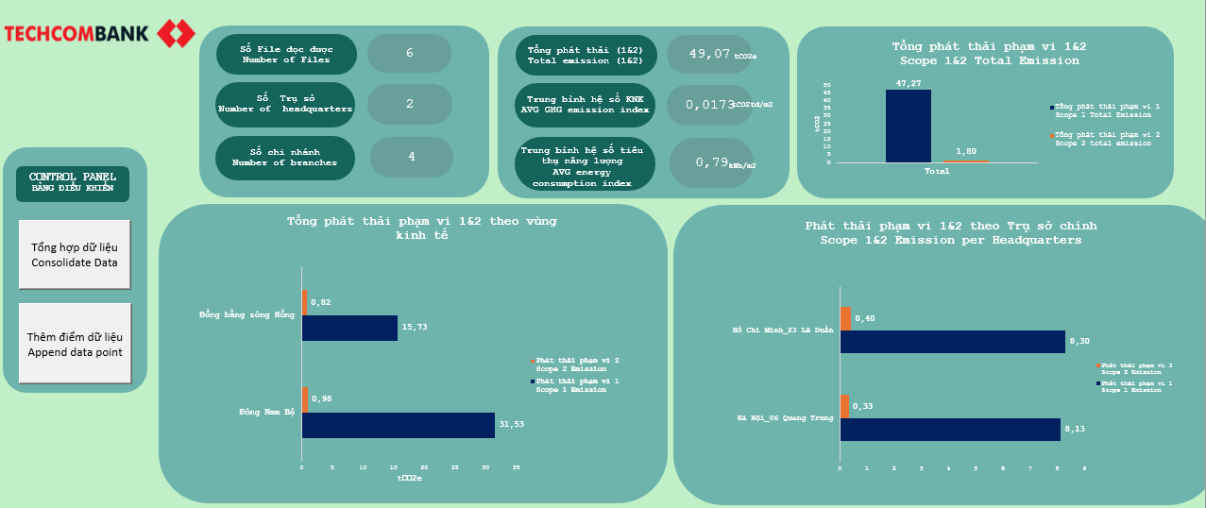
Commercial Champion Bank Collaboration:
TCB Progress Update - Scope 1 and 2 Report and Tool Completed
Scope 1&2 reduction: Completed
Scope 1&2 inventory toolkit: Completed

Slide 15

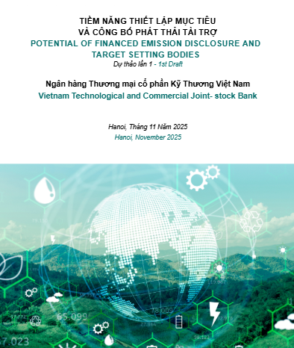
Commercial Champion Bank Collaboration:
TCB Progress Update - Scope 3 Financed Report and Tool in Progress
Scope 3 financed database: In progress
Scope 3 financed: In progress
Scope 3 setting target: In progress

Slide 16
Looking Ahead:
Proposed 2026 GTB Vietnam Activities
Proposed Engagement for 2026:
Provide advanced analytics and training for banks on quantifying financed emissions, setting science-based targets, and embedding climate intelligence into core lending decisions
Address the market gap by offering hands-on support for relationship managers and product teams on structuring credible and ambitious green and sustainability-linked transactions
Questions and Discussion
Questions from Tara on our Greening the Banks Vietnam project?
Further insights on Tara’s 2026 requirements and timelines?
Trilateral arrangement between BIDV, Tara and Allotrope timelines?
Consideration for commercial banks instrumental in facilitating energy transition in Vietnam?

Slide 17
Questions and Discussion
Discussion
Questions from Tara across both projects?
Further insights on Tara’s 2026 requirements and timelines?

Slide 18
State-Owned Champion Bank Collaboration:
BIDV Progress Update - Summary
Scope 1, 2 & 3 GHG Inventory Reports
Scope 3 Non-Financed:
Completed
1
Scope 3 Financed:
Finalizing report
Scope 3 Financed:
The report is expected to be submitted to BIDV in December 2025
Net Zero Roadmap for Scope 1, 2 & 3, and Inventory Toolkits
Scope 1 & 2 reduction:
Completed
Scope 1 & 2:
Waiting for a response from BIDV
2
Scope 3 Non-Financed:
Data missing for evaluation in 13 of the remaining 14 categories because BIDV has not yet collected the data.
Scope 3 Non-Financed:
BIDV proposes transferring this report to the Report on Proposed Methods for Collecting Other Key Categories for 2026
Scope 3 Financed:
Finalizing report
Scope 3 Non-Financed:
After receiving feedback from the inventory report, the roadmap report will be finalized.
Toolkits: 2 of 3 completed
Notes:
Deliverable 1 Carbon footprint and Emissions reduction strategies (06 reports + 02 tools)
For BIDV:
1) Report for Scope 1&2 emission reduction (completed)
2) Report for Scope 3 non financed emission (completed)
3) Report for Scope 3 financed emission (almost completed)
4) Calculation tool for Scope 3 (non financed and financed) (almost completed)
For TCB:
1) Report for Scope 1&2 emission reduction (completed)
2) Report for Scope 3 financed emission (almost completed)
Deliverable 2 Net zero transition roadmap (02 report)
For BIDV:
1) Net zero transition roadmap for financed emission (not yet)
For TCB:
1) Report for setting target & financed emission disclosure (almost completed)

Slide 19
Commercial Champion Bank Collaboration:
TCB Progress Update - Summary
01
Scope 1&2
Wait until 2025 for the updated report
Updated report assessing
Techcombank ’s scope 1; 2 emissions
Inventory Tools Scope 1 and 2:
Completed
02
Scope 3 financed:
In progress for updating database
Scope 3 financed:
PCAF announce the new database
Estimation of
Techcombank’ financed
emission
Scope 3 toolkit:
In progress for updating database
03
Assessment of potential for report disclosure and setting target:
In progress
Potential of financed emission
disclosure and target
setting bodies

Slide 20
Case Study
Building the business case to paid onsite solar with BESS in Vietnam
Savings:
Solar + battery prices continue to trend downward
2-part tariff
Enhance energy security and resilience, capture more onsite RE
Etc
Case study screenshot if ready

Slide 21
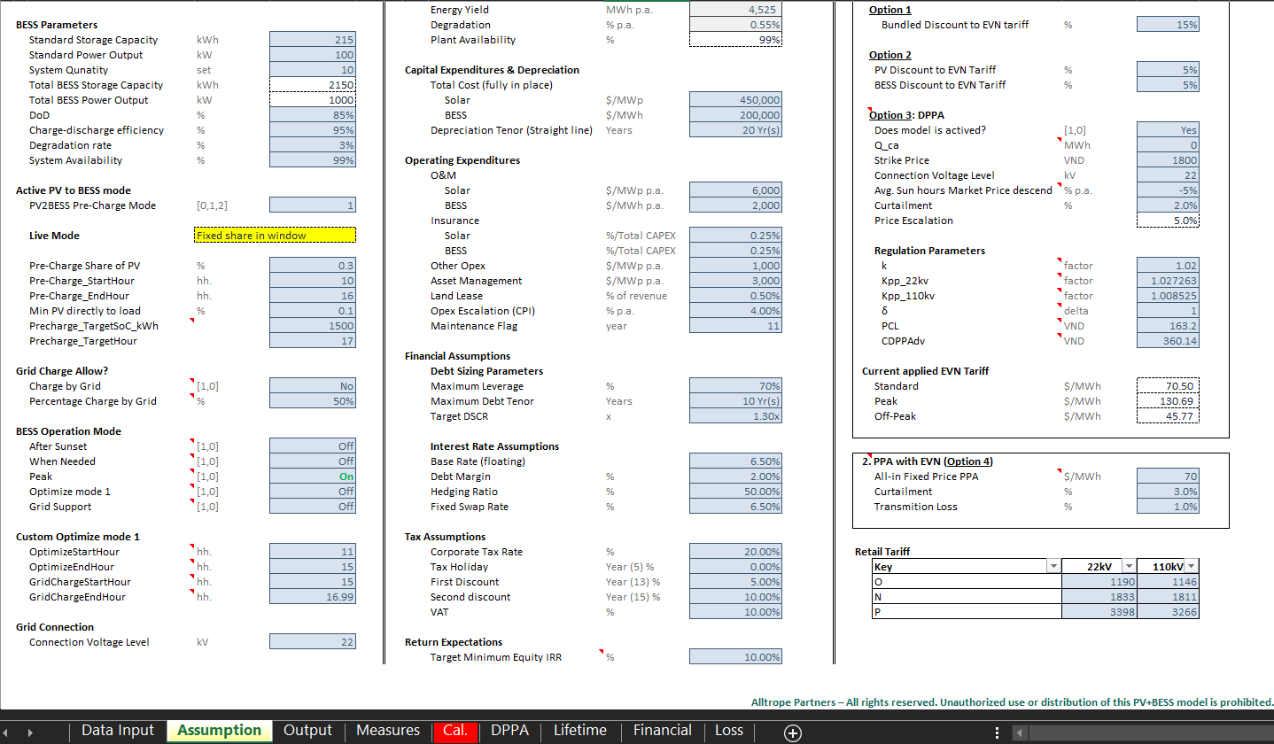
Site Analysis 2:
Ninh Sim Solar Farm: Utility-Scale BESS
Allotrope has developed a PV+BESS financial model to analyze the viability of solar plus battery storage.
Model Capabilities:
Simulates hourly PV generation and battery charge/discharge against load profiles and tariffs.
Conducts scenario analysis for various PPA structures.
Generates basic financial outputs and incorporates battery operation strategies.
Currently collecting project-specific data to run tailored simulations and produce a comprehensive project report.
Challenge: A significant barrier is the lack of a clear regulatory framework for a Direct Power Purchase Agreement (DPPA). This uncertainty prevents the team from making the financial assumptions needed to model project bankability, as it's unclear if industrial parks or private retailers can act as buyers.
Progress update:
EYA completed - Generation baseline validated (P50: 71.16 GWh) and now feeding into techno-economic modeling.
BESS model finalized - Dispatch logic, financial engine, and system inputs tested and integrated.
Scenario simulations ongoing - Evaluating Solar+BESS and alternative sizing for revenue, peak-shaving, and DPPA economics.
Report drafting in progress - Incorporating simulation outputs, sensitivities, and investment recommendations.
Next: finalize scenarios -> consolidate financials -> complete Assessment Report #2

Slide 22


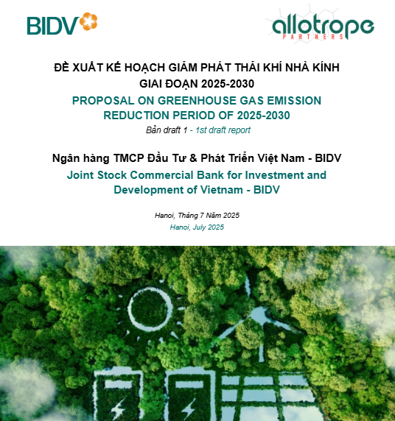
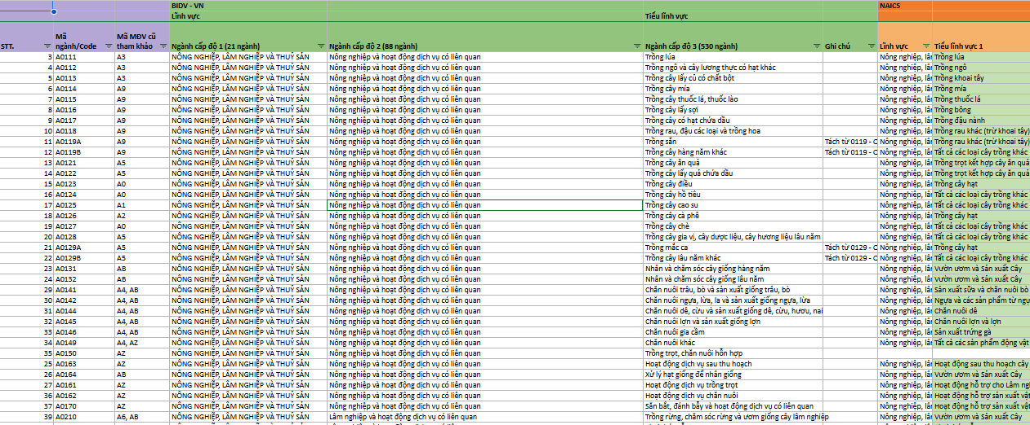
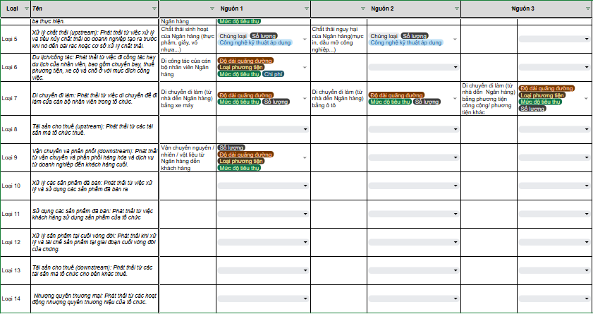
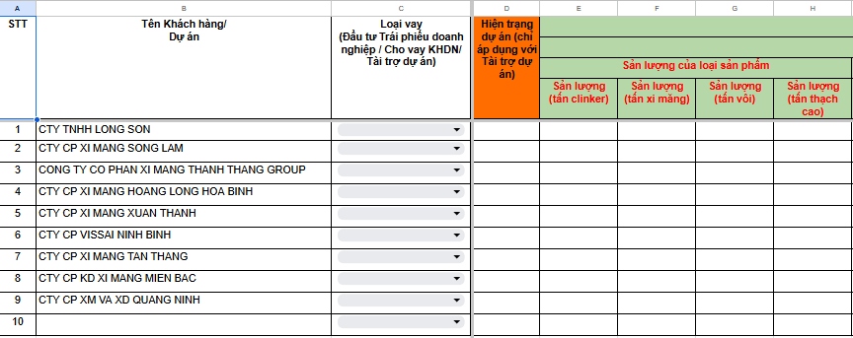
BIDV progress updated
Báo cáo Phạm vi 3 phi tài chính năm 2024:
Hoàn thiện đào tạo và đang thu thập dữ liệu
Báo cáo Phạm vi 3 tài chính năm 2024:
Hoàn thiện đào tạo và đang thu thập dữ liệu
Lộ trình giảm phát thải Phạm vi 1 và 2 năm 2024:
Đã hoàn thiện báo cáo

Slide 23
State-Owned Champion Bank Collaboration:
BIDV Progress Assessment - Sustainability Linked Loans
CHALLENGES
PROPOSED SOLUTIONS &
NEW DIRECTION
3
SLL Support
Economic context: Enterprises prioritize resources for business, green transformation is not urgent. Exporting enterprises only do enough to meet the conditions.
Technical: SLL has complex technical factors, affecting customers' decisions.
Financial: The current SLL lending interest rate does not create enough motivation; the current credit growth rate is quite low.
Business psychology: Fear of losing competitive advantage if ESG information is made public and concern about "greenwashing" suspicions due to unclear regulations in Vietnam.
New Strategy: Focus on some potential customers and expand the scope to support Transition Plans instead of focusing only on SLL loans, anticipating the application of emission quotas from 2026.
From now-Early 2025: BIDV will contact 20 old customers to promote SLL, arrange a meeting with 1 potential customer and Allotrope to consult in-depth on SLL.
Future Approach: Transition Plans

Slide 24
BIDV Progress Assessment - Financed Emission
1
Phạm vi 3 phi tài chính:
Đã hoàn thành đào tạo và gửi phiếu khảo sát
Phạm vi 3 phi tài chính:
Chưa nhận được kết quả khảo sát. Đã đề xuất lùi thời gian hoàn thiện báo cáo
Báo cáo kiểm kê KNK cho 3 phạm vi 1,2,3
Phạm vi 3 tài chính:
Đã hoàn thành đào tạo cho Phòng Ban/ Chi nhánh và tổ chức lấy dữ liệu trực tuyến
Phạm vi 3 tài chính:
Đã gửi lại bộ công cụ kiểm kê về phát thải tài chính cho 3 loại hình tài sản + 3 mã cho vay trọng yếu
2
Phạm vi 1,2:
Đã hoàn thiện kế hoạch giảm phát thải và bộ công cụ tính toán phát thải khí nhà kính
Phạm vi 1,2:
Cần đề xuất họp với Ngân hàng để đánh giá tính khả thi của báo cáo
Lộ trình Net Zero cho 3 phạm vi 1,2,3 và Công cụ tính toán
Phạm vi 3 phi tài chính:
Chưa thực hiện kiểm kê nên chưa đề xuất lộ trình
Phạm vi 3 phi tài chính:
Cần làm việc với Ngân hàng để sớm hoàn thiện Báo cáo phát thải của phạm vi này
Phạm vi 3 tài chính:
Chưa thực hiện kiểm kê nên chưa đề xuất lộ trình
Phạm vi 3 tài chính:
Cần làm việc với Ngân hàng để sớm hoàn thiện Báo cáo phát thải của phạm vi này

Slide 25

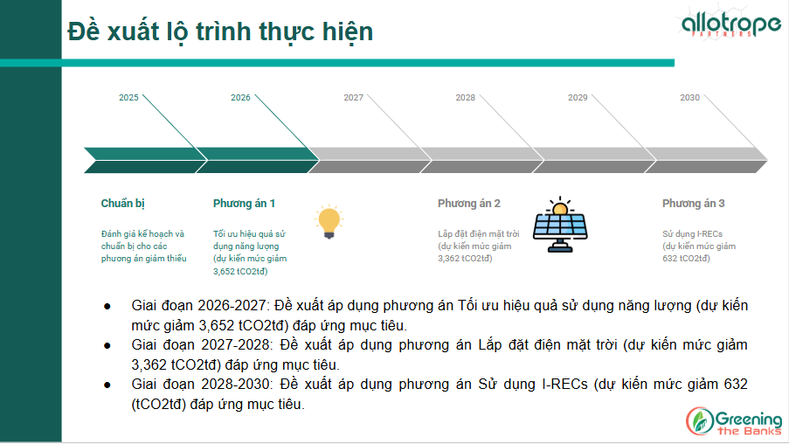
TCB progress updated
Báo cáo Kế hoạch giảm phát thải cho Phạm vi 1 và 2: Đã hoàn thiện
Công cụ thu thập và tổng hợp dữ liệu về kiểm kê KNK cho Phạm vi 1 và 2: Đã hoàn thiện

